Slide 1
Chapter 5: Diffusion in Solids
ISSUES TO ADDRESS...
• How does diffusion occur?
• Why is it an important part of processing?
• How can the rate of diffusion be predicted for
some simple cases?
• How does diffusion depend on structure
and temperature?

Slide 2
Diffusion
Diffusion - Mass transport by atomic motion
Mechanisms
Gases & Liquids – random (Brownian) motion
Crystalline Solids – vacancy diffusion or interstitial diffusion
Notes:
Diffusion mechanism depends on material

Slide 3

Processing Using Diffusion
• Case Hardening:
--Diffuse carbon atoms
into the host iron atoms
at the surface
--Example of interstitial
diffusion is a case
hardened gear
• Result: The presence of C atoms makes iron (steel) harder

Slide 4
Processing Using Diffusion
• Doping silicon with phosphorus for n-type semiconductors:
• Process:
1. Deposit P rich
layers on surface.
silicon
2. Heat it.
3. Result: Doped
semiconductor
regions.
Color coded atomic maps of element
distribution in a Si device (EDS)
silicon

Slide 5
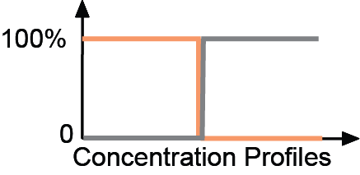
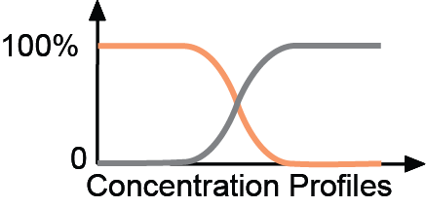
Solid-state Diffusion
• Interdiffusion: In an alloy, atoms tend to migrate
from regions of high conc. to regions of low conc.
Initially
After some time

Slide 6
Solid-state Diffusion
• Self-diffusion: In an elemental solid, atoms also migrate
Label some atoms
After some time
C
C
A
D
A
D
B
B

Slide 7
Diffusion Mechanisms
Vacancy Diffusion:
• atoms exchange with vacancies
• applies to substitutional impurity atoms
• rate depends on:
--number of vacancies
--activation energy to exchange
increasing elapsed time

Slide 8

Diffusion Simulations
1. Diffusion couple between A/B
2. Slice with fixed amount of material
3. Source at edge of sample
• Simulation of
interdiffusion
across an interface:
• Rate of substitutional
diffusion depends on:
--vacancy concentration
--frequency of jumping.

Slide 9
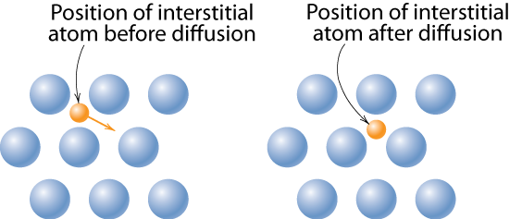
Diffusion Mechanisms
Interstitial diffusion – smaller atoms can diffuse between atoms.
More rapid than vacancy diffusion
Notes:
this is essentially mechanism in amorphous materials such as polymer membranes

Slide 10
Diffusion
How do we quantify the amount or rate of diffusion?
Flux proportional to concentration gradient =
Fick’s first law of diffusion
D ≡ diffusion coefficient

Slide 11
Steady-State Diffusion
Rate of diffusion independent of time
C₁
C₁
C₂
C₂
x₁
x₂
x

Slide 12
Diffusion Coefficient
Rates of diffusion determined by D, the diffusion coefficient
D = (distance moved)² / time = x²/t
Typical units: cm²/sec or m²/sec
D for gases: ~0.2 cm²/sec
D for liquids: ~2 x 10⁻⁵ cm²/sec
D for solids: ~2 x 10⁻⁹ cm²/sec
Details depend on chemistry, temperature

Slide 13
Example: Chemical Protective Clothing (CPC)
Methylene chloride is a common ingredient of paint removers. Besides being an irritant, it also may be absorbed through skin. When using this paint remover, protective gloves should be worn.
If butyl rubber gloves (0.04 cm thick) are used, what is the diffusive flux of methylene chloride through the glove?
Data:
diffusion coefficient in butyl rubber: D = 110 x10⁻⁸ cm²/s
surface concentrations:
C₁ = 0.44 g/cm³
C₂ = 0.02 g/cm³

Slide 14
Example (cont).
Solution – assuming linear conc. gradient
glove
C₁
paint
remover
skin
C₂
Data:
D = 110 x 10⁻⁸ cm²/s
x₁
x₂
C₁ = 0.44 g/cm³
C₂ = 0.02 g/cm³
x₂ – x₁ = 0.04 cm

Slide 15
Diffusion and Temperature
• Diffusion coefficient increases with increasing T.
⎛
Q_{d}
⎞
D
=
D_{o}
exp
⎜
−
⎝
R
T
⎠
D
= diffusion coefficient [m²/s]
D_{o}
= pre-exponential [m²/s]
Q_{d}
= activation energy [J/mol or eV/atom]
R
= gas constant [8.314 J/mol-K]
T
= absolute temperature [K]

Slide 16
Diffusion and Temperature
D has exponential dependence on T
1500
1000
600
300
T(°C)
10⁻⁸
D (m²/s)
C in γ-Fe
D
>> D
C in α-Fe
interstitial
substitutional
C in α-Fe
Al in Al
10⁻¹⁴
Fe in α-Fe
C in γ-Fe
Fe in α-Fe
Fe in γ-Fe
Al in Al
Fe in γ-Fe
10⁻²⁰
0.5
1.0
1.5
1000 K/T
Hot
Cold

Slide 17
Example: At 300ºC the diffusion coefficient and activation energy for Cu in Si are
D(300ºC) = 7.8 x 10⁻¹¹ m²/s
Q_{d} = 41.5 kJ/mol
What is the diffusion coefficient at 350ºC?
D
transform data
ln D
Temp = T
1/T

Slide 18
Example (cont.)
T₁ = 273 + 300 = 573 K
T₂ = 273 + 350 = 623 K
D₂ = 15.7 x 10⁻¹¹ m²/s

Slide 19
Other factors
Diffusion FASTER for...
• open crystal structures
• materials w/secondary
bonding
• smaller diffusing atoms
• lower density materials
Diffusion SLOWER for...
• close-packed structures
• materials w/covalent
bonding
• larger diffusing atoms
• higher density materials

Slide 20
Non-steady State Diffusion
The concentration of diffusing species is a function of both time and position C = C(x,t)
In this case Fick’s Second Law is used
Fick’s Second Law
Note: similar Mathematics also applies for heat transfer
problems: C becomes temperature T, D becomes κ
(thermal diffusivity )
Notes:
In the non-steady state the concentration profile develops with time.

Slide 21
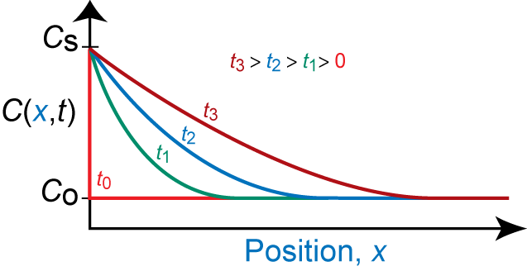
Non-steady State Diffusion
• Copper diffuses into a bar of aluminum.
Surface conc.,
C
of Cu atoms
bar
s
pre-existing conc., C_{o} of copper atoms
C
s
Adapted from Fig. 5.5, Callister 7e.
B.C. at t = 0, C = C_{o} for 0 ≤ x ≤ ∞
at t > 0, C = C_{S} for x = 0 (const. surf. conc.)
C = C_{o} for x = ∞

Slide 22
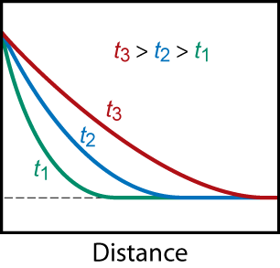
Solution:
C(x,t) = Conc. at point x at time t
erf (z) = error function
erf(z) values are given in Table 5.1
C_{S}
C(x,t)
C_{o}

Slide 23
Non-steady State Diffusion
Sample Problem: An FCC iron-carbon alloy initially containing 0.20 wt% C is carburized at an elevated temperature and in an atmosphere that gives a surface carbon concentration constant at 1.0 wt%. If after 49.5 h the concentration of carbon is 0.35 wt% at a position 4.0 mm below the surface, determine the temperature at which the treatment was carried out.
Solution: use Eqn. 5.5

Slide 24
Solution (cont.):
t = 49.5 h x = 4 x 10⁻³ m
C_{x} = 0.35 wt% C_{s} = 1.0 wt%
C_{o} = 0.20 wt%
∴ erf(z) = 0.8125

Slide 25
Solution (cont.):
We must now determine from Table 5.1 the value of z for which the error function is 0.8125. An interpolation is necessary as follows
z
erf(z)
0.90 0.7970
z 0.8125
0.95 0.8209
z = 0.93
Now solve for D

Slide 26
Solution (cont.):
To solve for the temperature at which D has above value, we use a rearranged form of Equation (5.9a);
from Table 5.2, for diffusion of C in FCC Fe
D_{o} = 2.3 x 10⁻⁵ m²/s Q_{d} = 148,000 J/mol
∴
T = 1300 K = 1027°C

